Slide 1
How does Businesses and Population Density affect Air Pollution?
Yurika Harada and Brian Liu

Slide 2
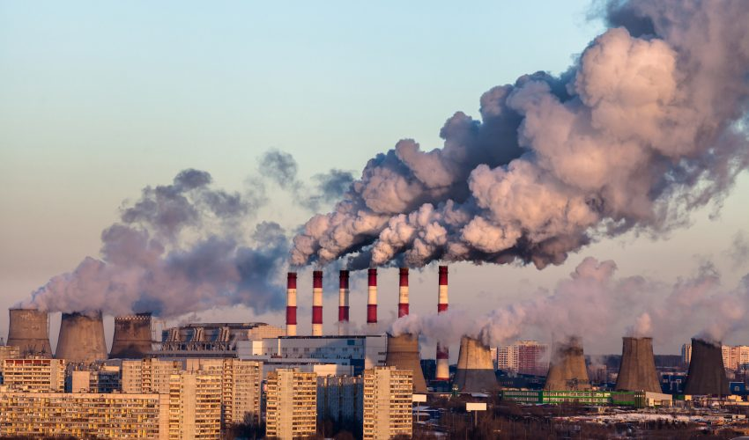
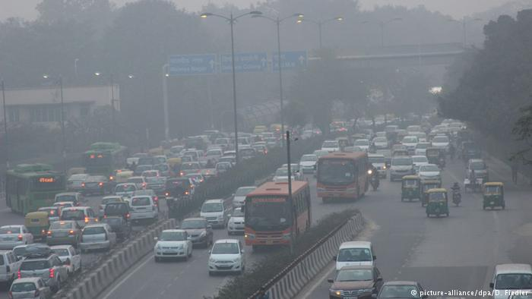
What is Air Pollution?
Air Pollution is defined as the release of chemicals into the air that negatively affect human health and the planet as a whole.
https://cff2.earth.com/uploads/2017/12/13122151/Air-pollution-linked-the-bad-behavior-in-teens-850x500.jpg. Accessed April 28, 2018.
http://www.dw.com/image/18953764_303.jpg. Accessed April 28, 2018.

Slide 3
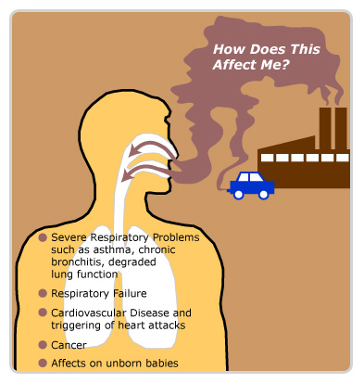
Why should we care?
Long term exposure can lead to several health issues including: asthma, cardiovascular disease, and death.
http://1.bp.blogspot.com/-PX35oeAv5FY/TypbOTpkyEI/AAAAAAAABM0/xvWxVDAq5bc/s1600/health-hazards.jpg. Accessed April 28, 2018.

Slide 4
What are the main sources of pollution for us?

Slide 5
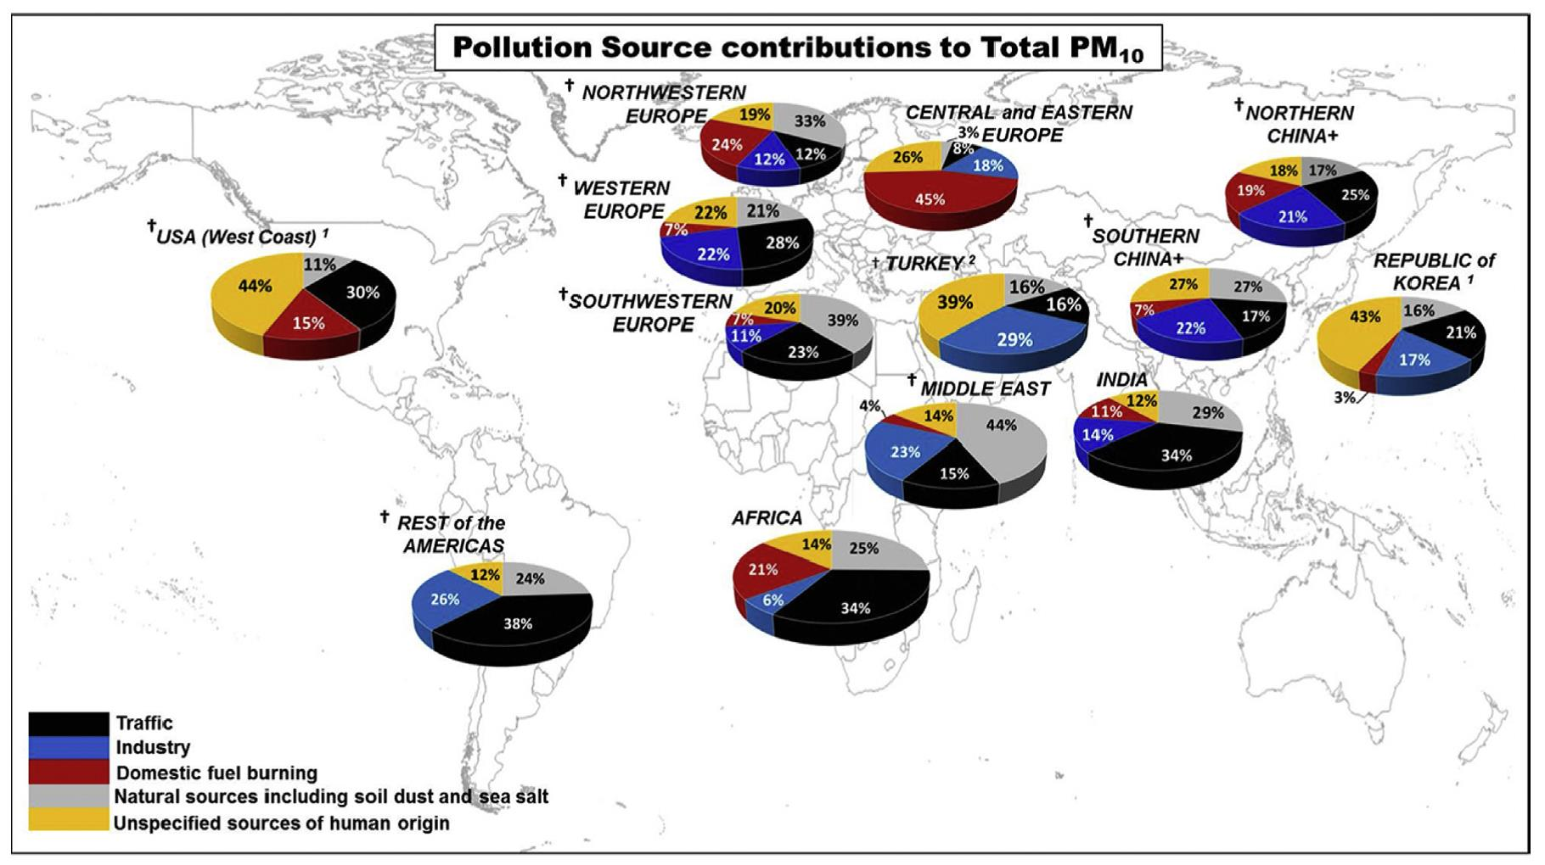
https://ec.europa.eu/jrc/en/news/what-are-main-sources-urban-air-pollution. Accessed on April 28, 2018.

Slide 6
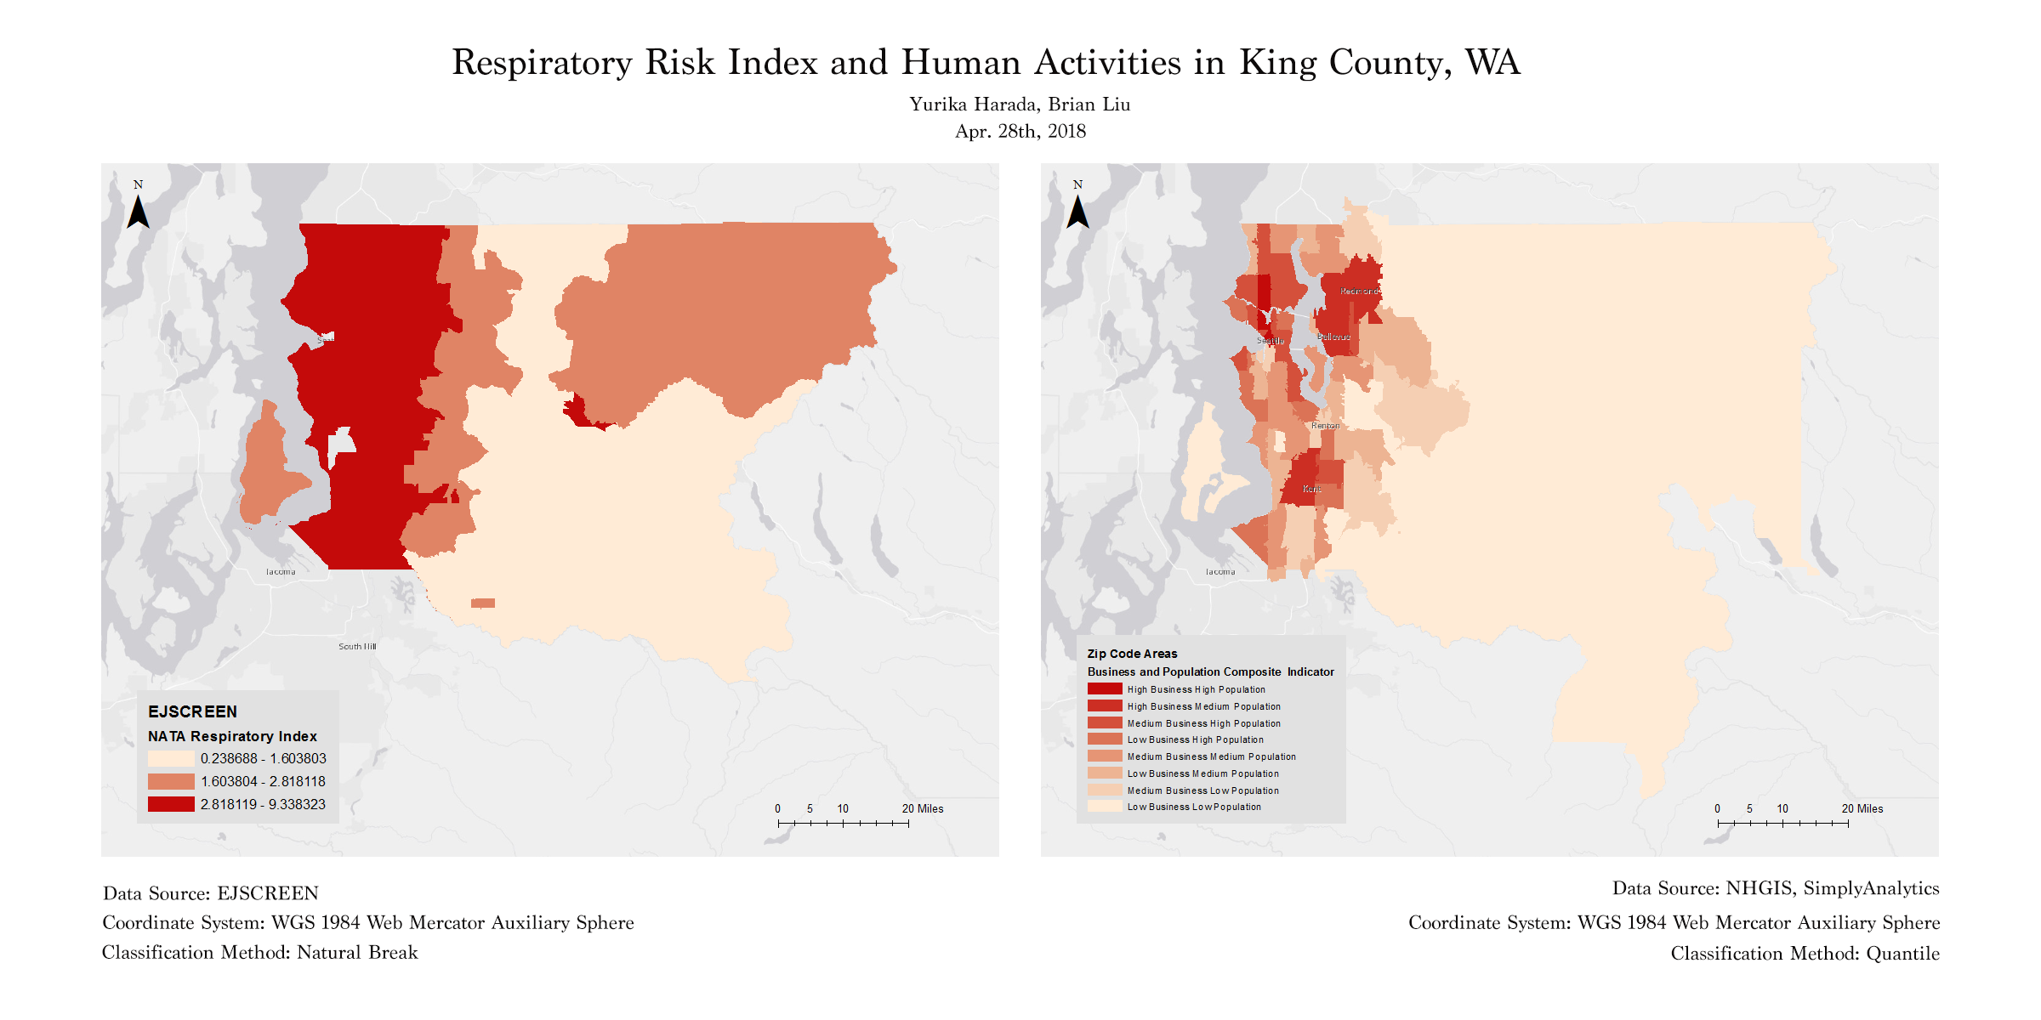

Slide 7
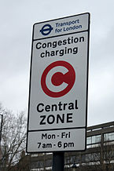
Mapping Conclusion and Other Findings
Both Business and Population Density affect the intensity of Air Pollutants in an area.
Suggested research has stated that having severe taxes on cars (congestion taxes) and increased use of light rails/subways can reduce the intensity of air pollutants.
https://upload.wikimedia.org/wikipedia/commons/thumb/e/e1/London_CC_12_2012_5045.JPG/145px-London_CC_12_2012_5045.JPG. Accessed April 28, 2018.

Slide 8
Sources
https://www.nrdc.org/stories/air-pollution-everything-you-need-know. Accessed on April 28, 2018.
http://www.enviropedia.org.uk/Air_Quality/Urban_Air_Quality.php. Accessed on April 28, 2018.
https://www.niehs.nih.gov/health/topics/agents/air-pollution/index.cfm. Accessed on April 28, 2018.
https://ec.europa.eu/jrc/en/news/what-are-main-sources-urban-air-pollution. Accessed on April 28, 2018.
https://www.epa.gov/ejscreen/what-ejscreen. Accessed on April 28, 2018.
https://app.simplyanalytics.com/login.html. Accessed on April 28, 2018.
https://www.nhgis.org/. Accessed April 28, 2018.

